Slide 1



BUILDATHON
Team Name
Raj Koli
Prathamesh swami
Ragini Singh
Ayush Kumar.
https://github.com/Rajkoli145/Buildathon.git

Slide 2
PROBLEM STATEMENT
Lack of Personalization: Generic career advice that doesn’t consider individual strengths and goals.
- Skills Mismatch: Growing gap between skills people have and what employers need.
- Complex Job Market: Hard to navigate new, emerging roles and industries.
- Limited Career Feedback: No ongoing insights on career progress and satisfaction.

Slide 3
OUR SOLUTION
.
AI-Driven Recommendations: Personalized career paths based on skills, personality, and trends.
- Career Path Visualization: Simulate job growth, salary, and satisfaction over time.
- Skill Gap Analysis: Identify and recommend courses to close skills gaps.
- Job Placement Assistance: Access to job listings and internships.
- Continuous Feedback: Ongoing insights into career milestones and adjustments.

Slide 4
TARGETED SECTOR & AUDIENCE
- Students & Graduates: Help with career selection after education.
- Mid-Career Professionals: Assistance with career transitions or growth.
- Hiring Partners: AI-driven candidate matching for better-fit hiring.
- Learning Platforms: Personalized course suggestions from platforms like Coursera.

Slide 5
MARKET RESEARCH
--Demand for Career Guidance: Increased need for personalized career support.
- AI Adoption: Growing use of AI in recruitment and career development.
- Skills Gap: Significant mismatch between available skills and market needs.
- Target Audience: Students, professionals, and employers seeking better talent.
- Competitive Advantage: Early entry into the AI-powered career guidance market.

Slide 6
PRODUCT FEATURES
- Personalized Career Matching: AI-driven suggestions based on user profile.
- Skill Gap Analysis: Identifies missing skills and recommends courses.
- Career Simulation: Visualize job outcomes like salary and job satisfaction.
- Job Placement Integration: Access to real-time job opportunities.
- Continuous Feedback: Adjust career paths based on progress.

Slide 7
TECHNICAL ARCHITECTURE
- User Profile: Secure storage of user data for tailored guidance.
- AI Matching Engine: Matches users to suitable career paths and jobs.
- Skill Gap Analyzer: Suggests courses to bridge skill gaps.
- Job Integration: Real-time job and internship opportunities.
- Cloud Infrastructure: Scalable, secure platform for data processing.

Slide 8
FUTURE SCOPE
- Global Expansion: Localized platforms for different regions.
- Advanced AI Features: Predictive analytics for job market trends and satisfaction.
- Corporate Solutions: Tailored services for employee development and recruitment.
- Learning Platform Partnerships: Expand partnerships with more online learning platforms.
- Improved Job Matching: Enhanced AI for better job-fit predictions.

Slide 9
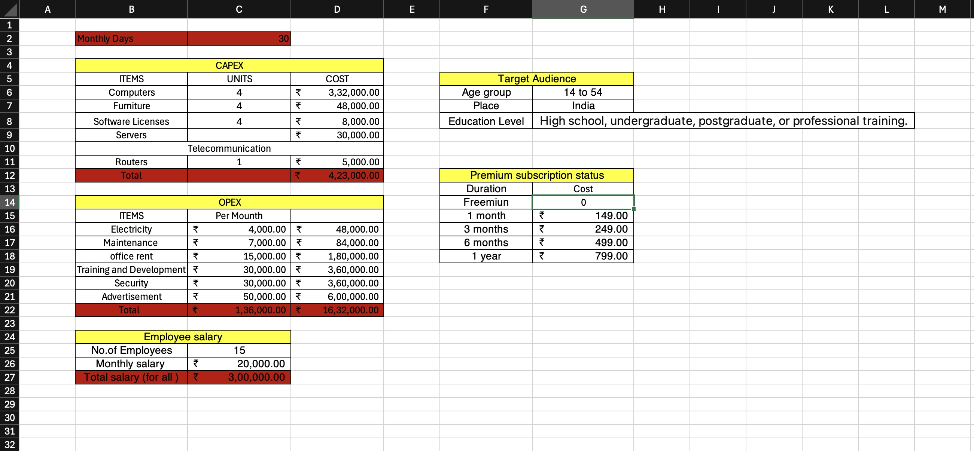
BUSINESS MODEL

Slide 10


